Slide 1
WELCOME

Slide 2
DATA SCIENCE FUNDAMENTAL
GOPIKRISHNA K.P
REGISTER NO. 961521103316

Slide 3
COURSE NAME :Data science fundamental
PROJECT TITLE :Movie Rating Discrepancy Analysis Using Python
PROJECT SUBMITTED TO :Anna University/Naan Mudhalavan
YEAR :3rd YEAR
DEPARTMENT :Civil Engineering
SEMESTER :6TH Semester

Slide 4
INTRODUCTION
Importance of movie ratings in shaping audience preferences and industry decisions.
Movie ratings influence viewers' choices, critics' reviews, and filmmakers' success.

Slide 5
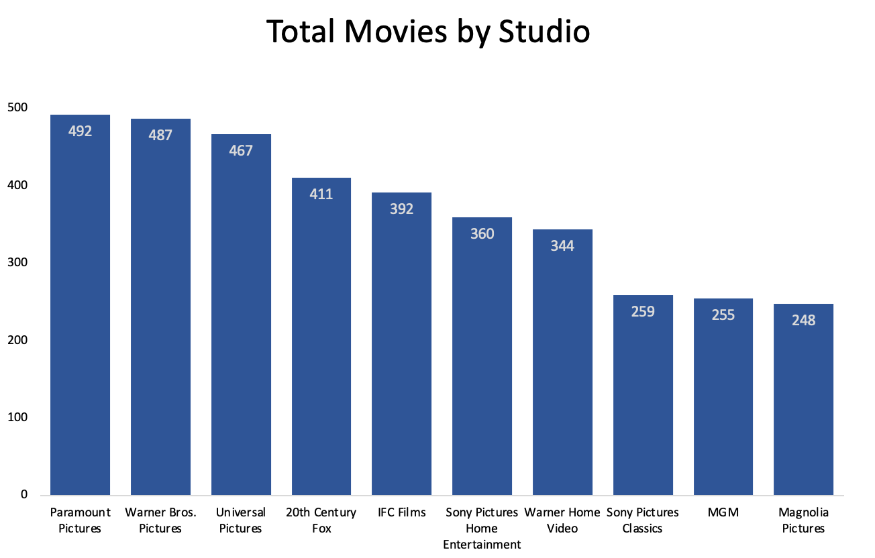
Graph showing the increasing reliance on online movie ratings platforms over the years.

Slide 6

Objective
To investigate and analyse discrepancies in movie ratings across different platforms using Python.
Explore why ratings for the same movie can vary significantly across platforms.
Illustration depicting different rating scores for the same movie on IMDb, Rotten Tomatoes, and Metacritic.
. Analyse movie rating data using Python

Slide 7
Data Collection
Sources of movie rating data (e.g., APIs, web scraping)
Discuss data cleaning and pre-processing techniques
Sample code snippets for data collection and pre-processing using Python libraries like Pandas and Beautiful Soup

Slide 8
Exploratory Data Analysis (EDA)
Overview of EDA techniques for movie rating data
Visualization of movie ratings distribution
Identify outliers and anomalies in the data
Use Python libraries such as Matplotlib and Seaborn for visualization

Slide 9
Rating Discrepancy Analysis
Explanation of rating discrepancy
Compare ratings from different sources (e.g., IMDb vs. Rotten Tomatoes)
Statistical analysis techniques to measure the level of discrepancy
Showcase Python code for analyzing rating discrepan

Slide 10
ALGORITHM AND DEPLOYEMENT
1 Data Collection:
Gather data from various sources such as movie rating websites (like IMDb, Rotten Tomatoes, Metacritic), user reviews, and possibly official ratings from movie studios or distributors.
2 Data Cleaning and Pre-processing:
Process the collected data to remove any inconsistencies, missing values, or irrelevant information. This may involve tasks such as parsing HTML, dealing with different data formats, and handling outliers.
3 Feature Engineering:
Extract relevant features from the data that could potentially explain rating discrepancies. These features could include movie genre, release year, director, cast, budget, runtime, etc.
4 Statistical Analysis:
Conduct statistical analysis to identify patterns and correlations within the data. This could involve techniques such as hypothesis testing, correlation analysis, or regression analysis.
5 Machine Learning Modelling:
Develop machine learning models to predict rating discrepancies based on the extracted features. This could involve techniques such as linear regression, decision trees, random forests, or neural networks.
6 Model Evaluation:
Evaluate the performance of the machine learning models using appropriate metrics such as mean squared error, accuracy, precision, recall, etc. This step helps determine the effectiveness of the models in predicting rating discrepancies.
7 Deployment
Once a satisfactory model is trained and evaluated, deploy it into a production environment where it can be accessed by users. This could involve creating a web application, API, or integrating the model into an existing platform.

Slide 11
Case Study
Present a case study example of rating analysis for a set of movies
Demonstrate how Python was used to uncover rating discrepancies
Discuss findings and insights from the case study

Slide 12
RECOMMENDATIONS
Suggestions for addressing rating discrepancies
Importance of using multiple rating sources
Encourage transparency and accountability in rating systems

Slide 13
CONCLUSION
Summary of key points covered in the presentation
Reiterate the importance of movie rating analysis
Encourage further exploration and research in the field

Slide 14
REFERENCES
Web Scraping IMDb:
Web Scraping with Python" by Ryan Mitchell provides a comprehensive guide to web scraping techniques using Python, which could be handy for extracting movie ratings from IMDb.
Data Analysis with Python:
Python for Data Analysis" by Wes McKinney is a great resource for learning data analysis techniques in Python using libraries like Pandas and NumPy.
Data Visualization:
Python Data Visualization Cookbook" by Igor Milovanovic provides recipes to create effective visualizations using libraries like Matplotlib, Seaborn, and Portly.

Slide 15
THANK YOU

